Slide 1
Chapter 1: Introduction

Slide 2
Chapter 1: Introduction
What Operating Systems Do
Computer-System Organization
Computer-System Architecture
Operating-System Operations
Resource Management
Security and Protection
Virtualization
Distributed Systems
Kernel Data Structures
Computing Environments
Free/Libre and Open-Source Operating Systems

Slide 3
Objectives
Describe the general organization of a computer system and the role of interrupts
Describe the components in a modern, multiprocessor computer system
Illustrate the transition from user mode to kernel mode
Discuss how operating systems are used in various computing environments
Provide examples of free and open-source operating systems

Slide 4
What Does the Term Operating System Mean?
An operating system is “fill in the blanks”
What about:
Car
Airplane
Printer
Washing Machine
Toaster
Compiler
Etc.

Slide 5
What is an Operating System?
A program that acts as an intermediary between a user of a computer and the computer hardware
Operating system goals:
Execute user programs and make solving user problems easier
Make the computer system convenient to use
Use the computer hardware in an efficient manner

Slide 6
Computer System Structure
Computer system can be divided into four components:
Hardware – provides basic computing resources
CPU, memory, I/O devices
Operating system
Controls and coordinates use of hardware among various applications and users
Application programs – define the ways in which the system resources are used to solve the computing problems of the users
Word processors, compilers, web browsers, database systems, video games
Users
People, machines, other computers

Slide 7
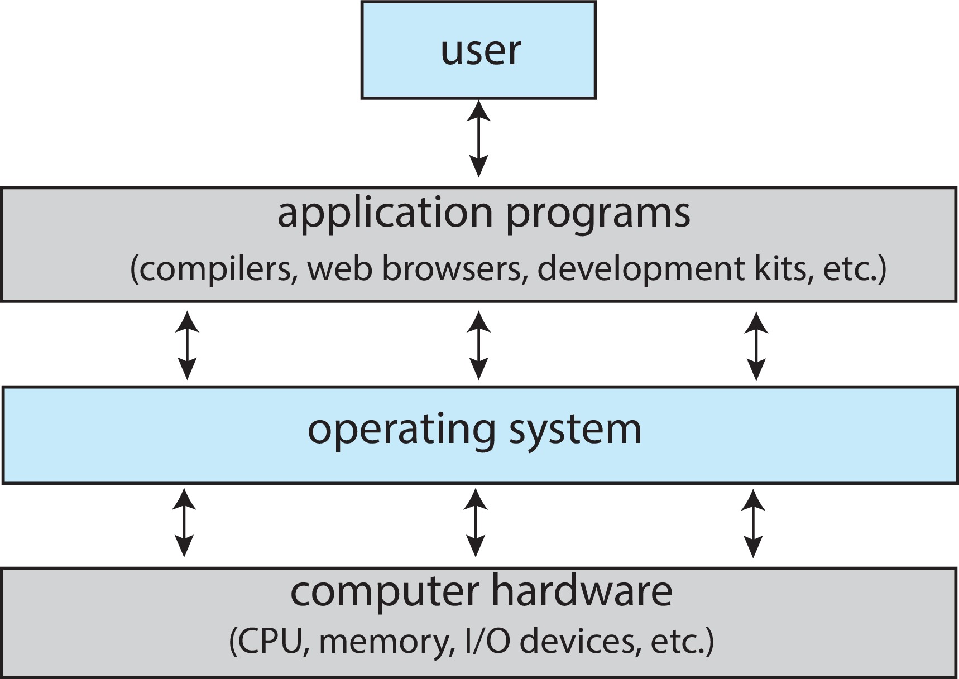
Abstract View of Components of Computer

Slide 8
What Operating Systems Do
Depends on the point of view
Users want convenience, ease of use and good performance
Don’t care about resource utilization
But shared computer such as mainframe or minicomputer must keep all users happy
Operating system is a resource allocator and control program making efficient use of HW and managing execution of user programs
Users of dedicate systems such as workstations have dedicated resources but frequently use shared resources from servers
Mobile devices like smartphones and tables are resource poor, optimized for usability and battery life
Mobile user interfaces such as touch screens, voice recognition
Some computers have little or no user interface, such as embedded computers in devices and automobiles
Run primarily without user intervention

Slide 9
Defining Operating Systems
Term OS covers many roles
Because of myriad designs and uses of OSes
Present in toasters through ships, spacecraft, game machines, TVs and industrial control systems
Born when fixed use computers for military became more general purpose and needed resource management and program control

Slide 10
Operating System Definition
No universally accepted definition
“Everything a vendor ships when you order an operating system” is a good approximation
But varies wildly
“The one program running at all times on the computer” is the kernel, part of the operating system
Everything else is either
A system program (ships with the operating system, but not part of the kernel) , or
An application program, all programs not associated with the operating system
Today’s OSes for general purpose and mobile computing also include middleware – a set of software frameworks that provide additional services to application developers such as databases, multimedia, graphics

Slide 11
Real-Time Embedded Systems
Real-time embedded systems most prevalent form of computers
Vary considerable, special purpose, limited purpose OS, real-time OS
Use expanding
Many other special computing environments as well
Some have OSes, some perform tasks without an OS
Real-time OS has well-defined fixed time constraints
Processing must be done within constraint
Correct operation only if constraints met

Slide 12
Free and Open-Source Operating Systems
Operating systems made available in source-code format rather than just binary closed-source and proprietary
Counter to the copy protection and Digital Rights Management (DRM) movement
Started by Free Software Foundation (FSF), which has “copyleft” GNU Public License (GPL)
Free software and open-source software are two different ideas championed by different groups of people
https://www.gnu.org/philosophy/open-source-misses-the-point.en.html
Examples include GNU/Linux and BSD UNIX (including core of Mac OS X), and many more
Can use VMM like VMware Player (Free on Windows), Virtualbox (open source and free on many platforms - http://www.virtualbox.com)
Use to run guest operating systems for exploration

Slide 13
The Study of Operating Systems
There has never been a more interesting time to study operating systems, and it has never been
easier. The open-source movement has overtaken operating systems, causing many of them to be
made available in both source and binary (executable) format. The list of operating
systems available in both formats includes Linux, BUSD UNIX, Solaris, and part of macOS.
The availability of source code allows us to study operating systems from the inside out.
Questions that we could once answer only by looking at documentation or the behavior of an
operating system we can now answer by examining the code itself.
Operating systems that are no longer commercially viable have been open-sourced as well, enabling
us to study how systems operated in a time of fewer CPU, memory, and storage resources.
An extensive but incomplete list of open-source operating-system projects is available
from https://curlie.org/Computers/Software/Operating_Systems/Open_Source/
In addition, the rise of virtualization as a mainstream (and frequently free) computer function
makes it possible to run many operating systems on top of one core system. For example, VMware
(http://www.vmware.com) provides a free “player” for Windows on which hundreds of free
“virtual appliances” can run. Virtualbox (http://www.virtualbox.com) provides a free, open-source
virtual machine manager on many operating systems. Using such tools, students can try out
hundreds of operating systems without dedicated hardware.
The advent of open-source operating systems has also made it easier to make the move from
student to operating-system developer. With some knowledge, some effort, and an Internet
connection, a student can even create a new operating-system distribution. Just a few years ago,
it was difficult or impossible to get access to source code. Now, such access is limited only by
how much interest, time, and disk space a student has.

Slide 14
Kernel Data Structure

Slide 15
Kernel Data Structures
Many similar to standard programming data structures
Singly linked list
Doubly linked list
Circular linked list

Slide 16
Kernel Data Structures
Binary search tree left <= right
Search performance is O(n)
Balanced binary search tree is O(lg n)

Slide 17
Kernel Data Structures
Hash function can create a hash map
Bitmap – string of n binary digits representing the status of n items
Linux data structures defined in include files <linux/list.h>, <linux/kfifo.h>, <linux/rbtree.h>

